Slide 1
Problem Statement Worksheet (Hypothesis Formation)
How can Big Mountain Resort maximize its profits in order to offset the cost of the new addition of lift chairs. Big Mountain needs to profit more than $1.5M in the upcoming season in order to capitalize on facilities.
H
1
Context
4
Constraints within solution space
Big Mountain resort needs profit over $1.5M this coming season due to the addition of the lift chairs. Ticket prices are based on the facilities offered at the resort.
2
Criteria for success
5
Stakeholders to provide key insight
Revenue increase for the season.
Director/s of operations
Operations managers
Database manager
3
Scope of solution space
6
Key data sources
Reduce operations of lifts in unpopular mountains , in order to reduce operation cost to increase profit. Or raise prices of tickets in order to increase profit without reducing operations.
CSV file obtained by the database manager.
H
D
E
I
P
Notes:
Hypothesis: Create a Hypothesis with an emphasis on SMART principles. (S – Specific, M – Measurable, A – Achievable, R – Realistic, T – Timebound). If you cannot do this, you do not have a good grasp on the business problem.
Context: With context, we have clearly identified the problem at hand and have elucidated on how our initiative may solve this problem, alongside the commercial implications this will have on the business.
Criteria for Success: Clearly defining the criteria for success ensures that the scope of your work is clearly defined and understood. Otherwise, if this isn’t defined – your work will never end which will result in mismatched expectations.
Scope of Solution Space: Scoping out the solution space ensures that the business initiative is SPECIFIC for a certain segment or area. This prevents solutions that have been developed being scaled and applied for all other business units that the solution may not be responsible or scalable for.
Constraints within Solution Space: Looking forward, what are the foreseeable problems we are likely to encounter? Could this be stakeholder resistance? Could this be we don’t have access to the right data?
Stakeholders to provide key insight: Who are the people I need to speak to, to get the answers I need for my data analysis?
What key data sources are required?
Based off my discussions with the key stakeholders – can we clearly list out all the data sources we need so we can make a highly targeted request as opposed to a scatter-gun approach where we ask for a bit of everything?

Slide 2
Key Findings:
From the Ski data Montana, where Big Mountain is located, is within the top 5 states that have the most skiable land.
Montana has 21410 square miles of skiable land.
The resort is also within the top 5 states to have resorts per capita, at 1.122
Recommendations:
Big Mountain should increase the prices of there tickets.
Big Mountain offers similar amenities that other resort offer, therefore Big Mountain have room to increase ticket prices.

Slide 3
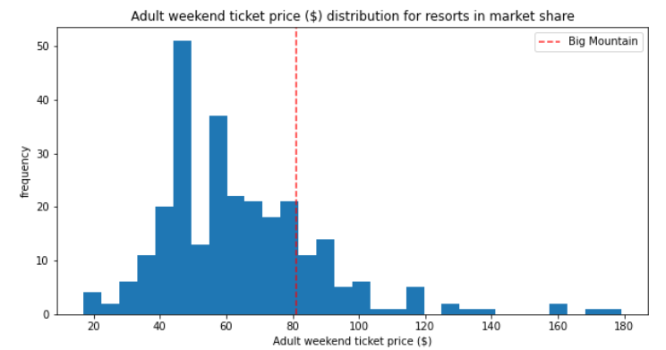
Models & Analysis:

Slide 4
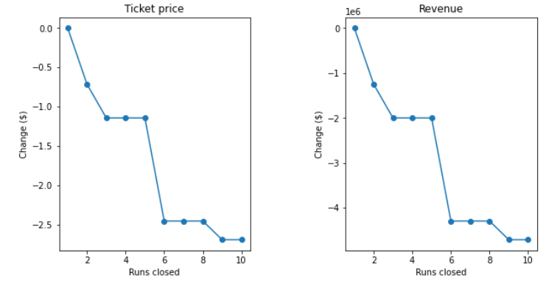
Models & Analysis:
If Big Mountain closes one run there is no difference. If more than 3 runs close down the resort will no longer be competitive in amenities to other resort, which will lead to low revenue.

Slide 5
Models & Analysis:
By adding a run, increasing the vertical drop will allow for a ticket increase of $9, which will be an $15,791,667 in profits
Adding 2 acres of snow making will not make no difference in the profits of the resort.

Slide 6
Summary & Conclusion:
Big Mountain needs to increase the price of their tickets in order to increase revenue.
Big Mountain offers similar amenities to other resorts throughout the U.S therefore the increase in the ticket prices is justified.

